Slide 1
Fake News Legislations and the Impact on Freedom of Expression in Southeast Asia
Dr. Robin Ramcharan, Executive Director

Slide 2
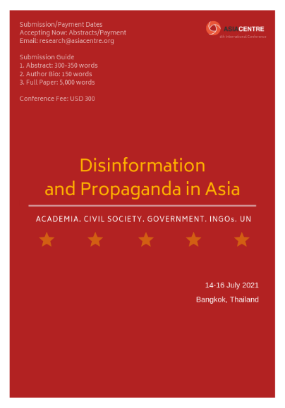
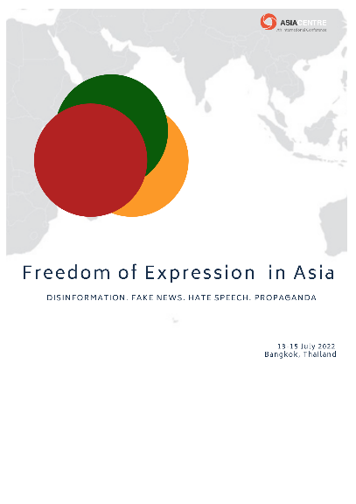
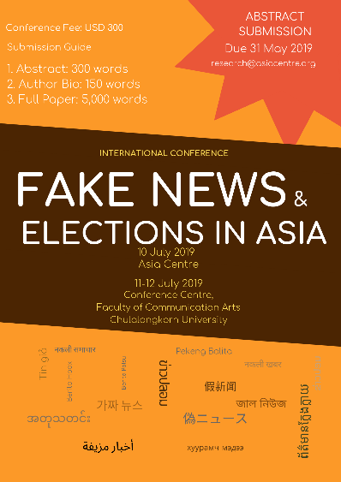
Freedom of Expression (SEA) Project 2019-2021
Over period of 4 years, the project examine the impact of fake news, hate speech, disinformation and propaganda on Freedom of expression in the region
Research - Baseline studies, policy briefs, commentaries
Regional (1) and Country (10)
Activities
1. National seminars
2. Interregional conference
3. International conferences
Fake News and Elections in Asia (10 – 12 Jul. 2019)
Hate Speech in Asia: Challenges and Solutions (8 – 10 Jul. 2020)
Authoritarian Disinformation and Propaganda in Asia (14 – 16 Jul. 2021)
Freedom of Expression in Asia (13 – 15 Jul, 2022)
Advocacy
Media engagement
Speaking engagement

Slide 3
Challenges of Information Disorder in ASEAN
Since the introduction of internet in Southeast Asia in 1995, incumbent regimes have used legislation to negate the democratic potential of the internet
Discussions around fake news bills surfaced in Asia after hotly debated voting results in other jurisdictions, notably following the 2016 US elections and the 2016 Brexit vote in the UK
Since 2017, individual SEA governments have taken legal and/or sponsor non-legal measures to combat “fake news”
In May 2018 ASEAN ministers responsible for information agreed in a joint statement to collaborate and exchange best practices to combat fake news and mitigate its effects

Slide 4
Global Media and Communication Trends
Population: 7.676, Internet: 4.388, Social Media: 3.484, Mobile Social Media: 3.256 (Billion)
A transition of media consumption from traditional media towards digital media
Shift in news consumptions from online to social media platforms
Facebook, Twitter, YouTube – top platforms
Content creation immediate, decentralized, diverse not subject to regulations or fixed standards
Technical and social filters result in filter bubbles and echo chambers

Slide 5
Fake News - Definition
“Deliberate presentation of false or misleading claims as news, where the claims are misleading by design.” Axel Gelbert (2018)
It has to be false, intentionally designed to be false.
It must be disseminated in a volume equivalent to that of news (i.e. attending wide circulation).
a degree of impact or success in materializing the objective of dissemination and uptake, which serve as a catalyst for further action.

Slide 6
Fake News - Definition
“Deliberate presentation of false or misleading claims as news, where the claims are misleading by design.”
Axel Gelbert (2018)
Fake news conflates three subsets of information disorder:
Disinformation - Information that is false and deliberately created to harm a person, social group, organization or country
Misinformation - Information that is false, but not created with the intention of causing harm.
Malinformation - Information that is based on reality, used to inflict harm on a person, organization or country.
Council of Europe’s Information Disorder Report

Slide 7
What is the Debate around Fake News?
Fake according to whom?

Slide 8
Internet and Social Media Penetration in Southeast Asia in 2019
Countries | Population | Internet penetration | Social media penetration | WhatsApp | Facebook | Youtube | IG | FB messenger | Other
Brunei | 436,700 | 94% (410,800) | 94% (410,000) | 398,476 | 350,000 | N/A | 220,000 | N/A | Twitter: 84,900
Cambodia | 16,360,000 | 76% (12,500,000) | 51% (8,400,000) | N/A | 8,300,000 | N/A | 690,000 | N/A | Twitter: 200,000
Indonesia | 268,200,000 | 56% (150,000,000) | 56% (150,000,000) | 124,500,000 | 121,500,000 | 132,000,000 | 120,000,000 | 70,500,000 | LINE: 88,500,000 Twitter: 78,000,000
Laos PDR | 7,010,000 | 39% (2,700,000) | 39% (2,700,000) | N/A | 2,700,000 | N/A | 240,000 | N/A | Twitter: 119,900
Malaysia | 32,250,000 | 80% (25,840,000) | 78% (25,000,000) | 23,514,400 | 23,514,400 | 24,031,200 | 18,088,000 | 16,537,600 | WeChat: 12,144,800 Twitter: 11,369,600
Myanmar | 54,100,000 | 39% (21,000,000) | 39% (21,000,000) | N/A | 21,000,000 | N/A | 810,000 | N/A | N/A
Philippines | 107,300,000 | 71% (76,000,000) | 71% (76,000,000) | 20,520,000 | 73,720,000 | 72,960,000 | 48,640,000 | 67,640,000 | Twitter: 41,040,000
Singapore | 5,830,000 | 84% (4,920,000) | 79% (4,600,000), -4.2% | 4,231,200 | 4,034,400 | 4,280,400 | 2,902,800 | 2,558,400 | Twitter: 1,672,800 WeChat: 1,623,600
Thailand | 69,240,000 | 82% (57,000,000) | 74% (51,000,000) | 14,250,000 | 53,010,000 | 51,870,000 | 37,050,000 | 41,040,000 | LINE: 47,880,000 Twitter: 29,640,000
Vietnam | 96,960,000 | 66% (64,000,000) | 64% (62,000,000) | 19,392,000 | 92,112,000 | 93,081,600 | 49,449,600 | 76,598,400 | Twitter: 35,875,200 Zalo: 71,750,400

Slide 9
Internet and Social Media Penetration in Southeast Asia in 2019 (cont’d)
Countries | Population | Average daily Internet use (hrs.) | Average daily social media use (hrs.) | Active mobile internet user | Total number of social media user accessing via mobile/ (% increase year on year)
Brunei | 436,700 | N/A | N/A | 83% (360,700) | 82% (360,000), +2.9%
Cambodia | 16,360,000 | N/A | N/A | 74% (12,050,000) | 49% (8,100,000), +29%
Indonesia | 268,200,000 | 8 hours 36 minutes | 3 hours 26 minutes | 53% (142,800,000) | 48% (130,000,000), +8.3%
Laos PDR | 7,010,000 | N/A | N/A | 37% (2,600,000) | 37% 2,600,000), +18%
Malaysia | 32,250,000 | 8 hours 05 minutes | 2 hours 58 minutes | 77% (24,890,000 | 74% (24,000,000), +9.1%
Myanmar | 54,100,000 | N/A | N/A | 38% (20,790,000) | 39% (21,000,000), +31%
Philippines | 107,300,000 | 10 hours 02 minutes | 4 hours 12 minutes | 67% (71,440,000) | 67% (72,000,000), +16%
Singapore | 5,830,000 | 7 hours 02 minutes | 2 hours 08 minutes | 79% (4,580,000) | 72% (4,200,000), -2.3%
Thailand | 69,240,000 | 9 hours 11 minutes | 3 hours 11 minutes | 79% (55,010,000) | 71% (49,000,000), +6.5%
Vietnam | 96,960,000 | 6 hours 42 minutes | 2 hours 32 minutes | 64% (62,400,000) | 60% (58,000,000), +16%

Slide 10
Average Time spent on Traditional Media
Countries | Linear TV | Broadcast Radio | Print Press | Games Consoles
Indonesia | 2 hours 23 minutes | 43 minutes | 42 minutes | 1 hour 14 minutes
Malaysia | 2 hours 4 minutes | 1 hour 3 minutes | 43 minutes | 1 hour 9 minutes
Philippines | 2 hours 30 minutes | 57 minutes | 41 minutes | 1 hour 34 minutes
Singapore | 1 hour 33 minutes | 53 minutes | 34 minutes | 33 minutes
Thailand | 2 hours 26 minutes | 56 minutes | 1 hour 2 minutes | 1 hour 36 minutes
Vietnam | 1 hour 26 minutes | 29 minutes | 45 minutes | 52 minutes
Source: Global Web Index (2017), Digital vs. Traditional Media Consumption (2017)

Slide 11
Average Time spent on Media Consumption
(Digital vs. Traditional Media)
Countries | Digital | Traditional | Digital media time (%)
Indonesia | 8 hours 35 minutes | 5 hours 3 minutes | 63%
Malaysia | 8 hours 33 minutes | 5 hours 1 minute | 63%
Philippines | 8 hours 40 minutes | 5 hours 43 minutes | 60%
Singapore | 6 hours 41 minutes | 3 hours 35 minutes | 65%
Thailand | 8 hours 33 minutes | 6 hours 2 minutes | 59%
Vietnam | 6 hours 50 minutes | 3 hours 33 minutes | 66%
Source: Global Web Index (2017), Digital vs. Traditional Media Consumption (2017)

Slide 12
Election Dates in Southeast Asia
Countries | Previous elections | Next elections
Cambodia | 2018 general election
Indonesia | 2019 presidential election
Malaysia | 2018 general election
Myanmar | 2015 general election | 2020 general election
Philippines | 2019 mid-term election
Singapore | 2015 general election | 2020 general election
Thailand | 2019 general election
Brunei | No Election (Absolute Monarchy)
Laos | No Election (Communist State)
Vietnam | No Election (Communist State)

Slide 13
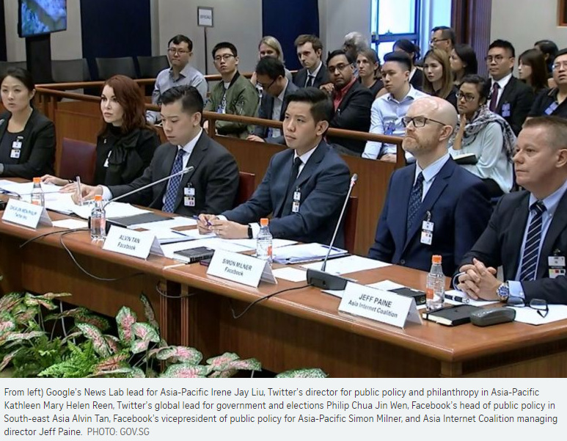
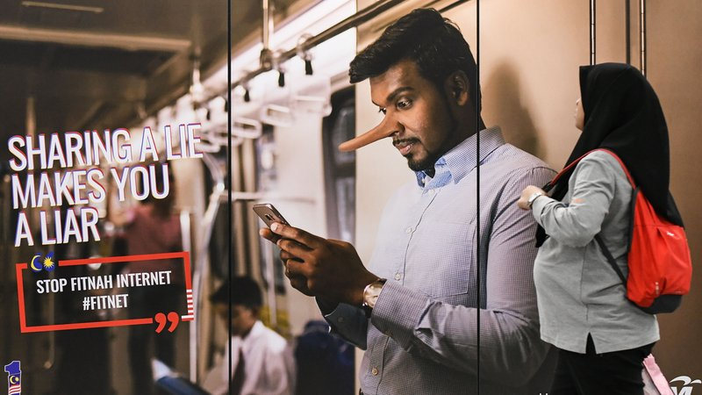
Types of Legislation Proposes/ Used
Governments have:
Revised existing law
Drafted new laws
Use existing law to deal with Fake News
What is illegal?
That which causes hatred, ill-will, riots and social unrests
That which causes reputational harm to government and its institutions
Foreign influence on domestic politics

Slide 14
Types of Legislation Proposes/ Used
Types of legislation proposes
Anti-fake news law (M’SIA, SG)
Cybersecurity law (INDO, TH, VN)
Types of existing laws use
Criminal defamation (CAM, MM)
Computer Crime Act (TH, MM)
Sedition Act (BRU, M’SIA)
Propaganda against the state (LAOS, VN)
Penalties:
1 - 20 year imprisonment
Fines from US$62 to US$ 724,000

Slide 15
Fake News and Other Legislations’ Punishments by Country
Countries | Regulation | Penalty | Responsible agency
Brunei | Sedition Act – Article 4 | 3-year imprisonment and/or US$ 4,500 fines. | Prime Minister’s Office
Cambodia | Inter-ministerial Regulation | 2-year imprisonment and/or US$ 1,000 fines. | Ministry of Information, Ministry of Interior, and Ministry of Post and Telecommunication
Indonesia | Revised Criminal Code – Article 309 | 6-year imprisonment and/or US$ 3,500 fines. | National Cyber and Encryption Agency
Laos | Article 65 of the Criminal Code Decree 327 | Up to 5 year imprisonment and a fine of between US$ 62 - 1,233 Not specify | Ministry of Public Security
Malaysia | Anti-Fake News Act 2018 | 6-year imprisonment and/or US$ 123,000 fines. | Ministry of Communications and Multimedia
Myanmar | Telecommunication Law – Article 66(d) Penal Code Article 505(b) | 3-year imprisonment 2-year imprisonment | Ministry of Information Ministry of Transport
Philippines | Anti-False Content Act (proposed) | Up to 20 year imprisonment and a fine of up to US$20,000 | Cybercrime Office, Department of Justice
Singapore | Protection from Online Falsehoods and Manipulation Bill (POFMA) | Failure to comply with ‘correction direction’ will result to: 1. S$ 20,000 for individuals and/or 1-year imprisonment at maximum 2. S$ 1,000,000 for service providers | Ministry of Law and Home Affairs Ministry of Communications and Information
Thailand | Computer Crimes Act 2017 (Revised) Cybersecurity Act | 1. 3-year imprisonment and/or US$ 6,000 fines. 2. Up to 3 year imprisonment and a fine of up to US$ 3,000 | Ministry of Digital Economy and Society Army Cyber Center Technology Crime Suppression Division – Royal Thai Police
Vietnam | Criminal Code – Article 117 (Revised) Cybersecurity Law | 1. 12-year imprisonment 2. Not specified yet | Ministry of Information and Communications Ministry of Public Security

Slide 16
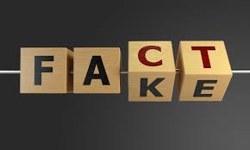
Non-Legal Developments in Southeast Asia
Governments have established task forces/agencies to monitor online discourses
Governments and CSOs (with support from donors and tech companies) have established fact-checking platforms or websites to correct false information on social media
Governments as well as universities and CSOs (with support from donors and technology companies) and technology companies are running media literacy programmes
Journalists/Media organisations (skills) and tech companies (priority search/feed) promote quality journalism

Slide 17
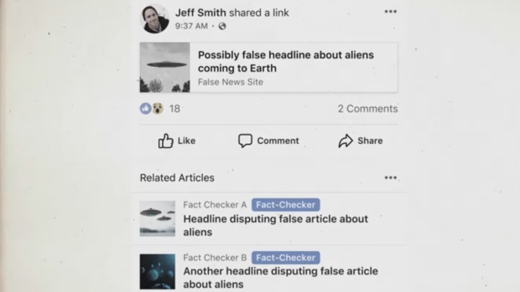
Role of Technology Companies
Technology companies take steps to combat fake news
Facebook:
admitted that it was ‘not doing enough to help prevent our platform from being used to foment division and incite offline violence in Myanmar’
hired 100 local Myanmar speakers to review content, closing down pages and accounts associated with key figures in the Myanmar Armed Force
increasingly uses local media outlets and NGOs as third party fact-checkers
introduced initiatives to increase oversight of political ads and limits political ad from foreign sources during elections
Whatsapp:
drastically limited forwarding message from 250 people to 20 people globally, and to only 5 in India

Slide 18
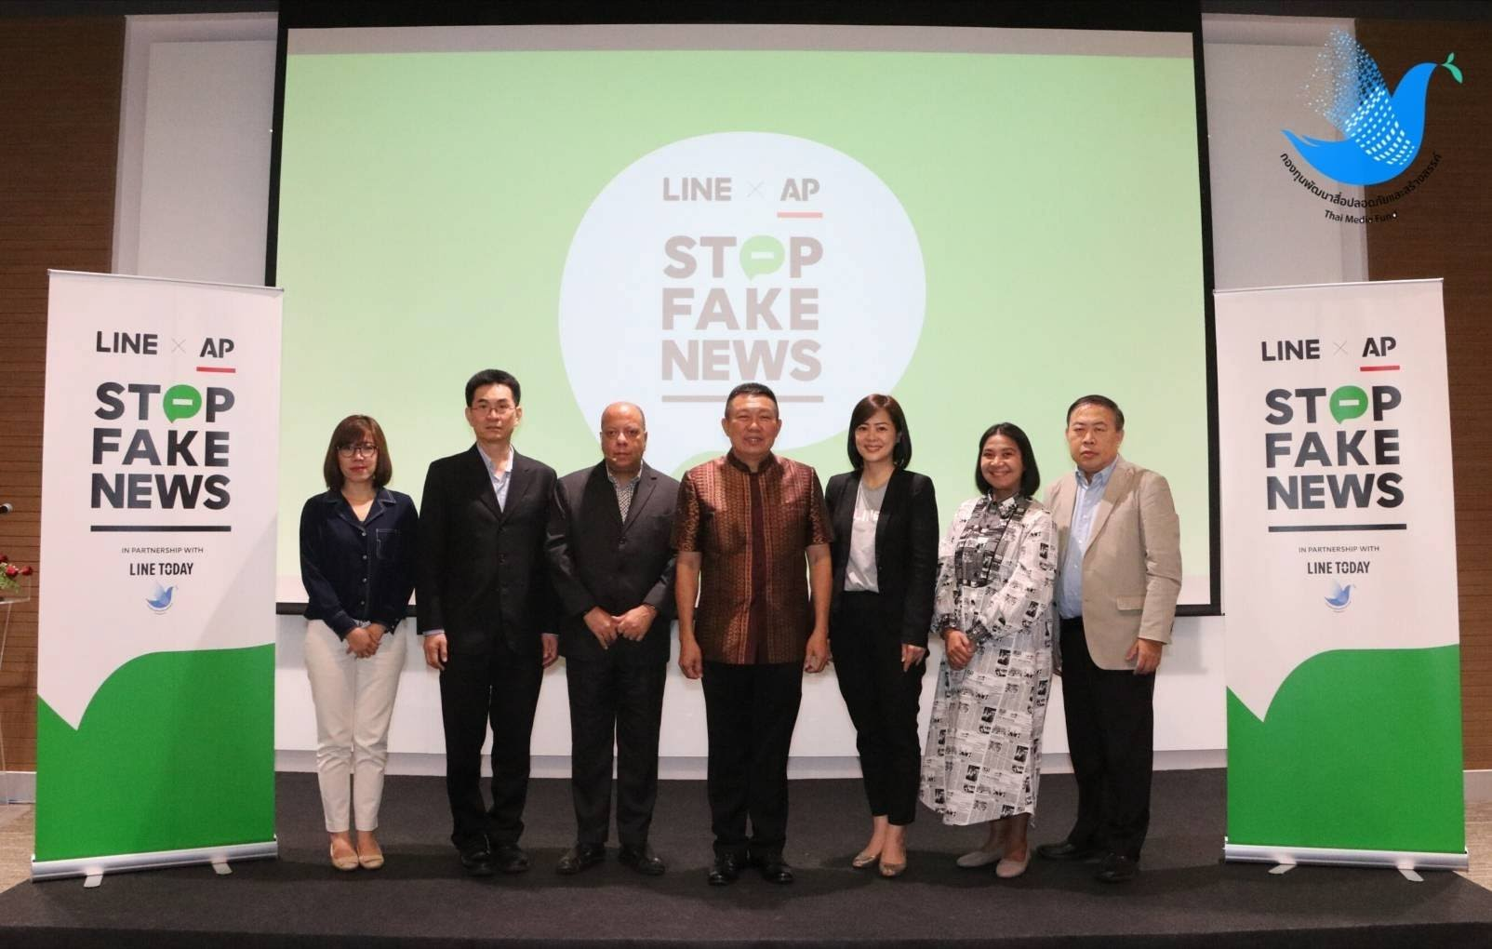
Role of Technology Companies (cont’d)
Google:
fights fake news by elevating quality journalism on their platforms. They rank news query results by relevance and authoritativeness.
Twitter:
suspended thousands of fake, automated accounts in Southeast Asia
Line:
sponsors media literacy programmes
But is this enough?

Slide 19
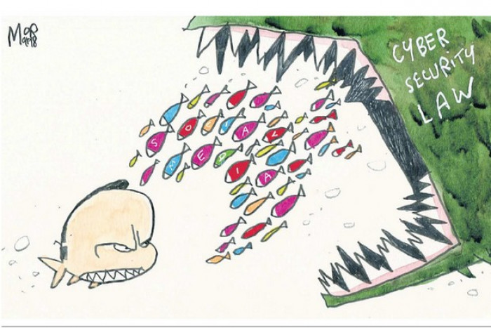
Challenges of Legal Measures
Legal Measures
Most of them are vaguely-worded laws leading to overcriminalization
complaint filed between individuals/politicians
complaints field by government agencies
Does not necessarily detoxify the post-truth ecosystem, but monopolize coercive action
Change in government’s policy
Malaysia’s repeal of anti-fake news law
Philippines’ fake news legislation

Slide 20
Challenges of Non-legal Measures
Non-legal Measure
Fact checkers themselves can be unreliable sources for what’s true or not.
fact checkers sometime check opinions, rather than factual claims
occurance of political bias of fact checkers/organisations
fact checking unable to match the speed of fake news
Quality Journalism
in Southeast Asia, there is a trust deficit in traditional journalism or mainstream media in many countries due to government control
drop in the consumption and volume of traditional media
unable to match viral power of fake news over online platforms

Slide 21
Challenges of Non-legal Measures (cont’d)
Media Literacy is offered and perceived as a ‘one-size-fits-all’ solution, while the more fundamental problem is lurking behind: lower trust in public institutions.
Epistemology concern: a large grey area between absolute truth and absolute falsehood. There’s a danger of assuming that what we are dealing with a rational process, or at least, by pedagogical means, be made rational.
Individualistic solution: judging what’s true or false depends, to certain extent, on the knowledge of content as well as form, understanding the topics’ context rather than how they are presented.
Reach of media literacy programmes and who funds the programme and what is deemed as truth.

Slide 22
Challenges of Technology Companies
Technology Companies’ response
Are the mechanisms in place really addressing the problem, or they are there just to manage the PR situation?
Tech companies’ support is weak and offer little transparency to their partners on what works and what doesn’t work.
Lack of a proper mechanism for emergency escalation.
Refusal to remove content, opt for demote it in the news feed so long as it does not violate its community standards.

Slide 23
Impact on Freedom of Expression in Southeast Asia
Unlike in the US where the President use ‘fake news’ to do reputational damage to the fact-based traditional media, in Southeast Asia government representatives are focused on discrediting, or wrongfooting critics.
As a result:
Government critics, political activists, CSO members impose self-exile in other countries where they study, take up jobs, or continue their activism as members of the diaspora.
Growing diaspora of Thai activists in France
CNRP members and political activists in Thailand
Vietnamese activists in Thailand
Some go underground and operate anonymously in their countries

Slide 24
Impact on Freedom of Expression in Southeast Asia
Fake news legislation allows governments to suppress criticism and as a result has created a chilling effect on freedom of expression and gives rise to self-censorship.
Fake news legislation is an evolution in the slew of legislation authoritarian regimes have been passing over the years against alternative content generated by online communications that is critical of incumbent regimes.

Slide 25
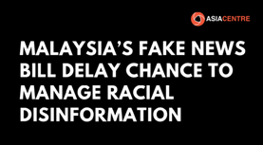
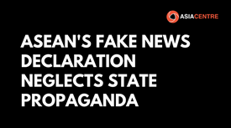
Asia Centre’s Ongoing Works on
Fake News and Freedom of Expression
Research

Slide 26
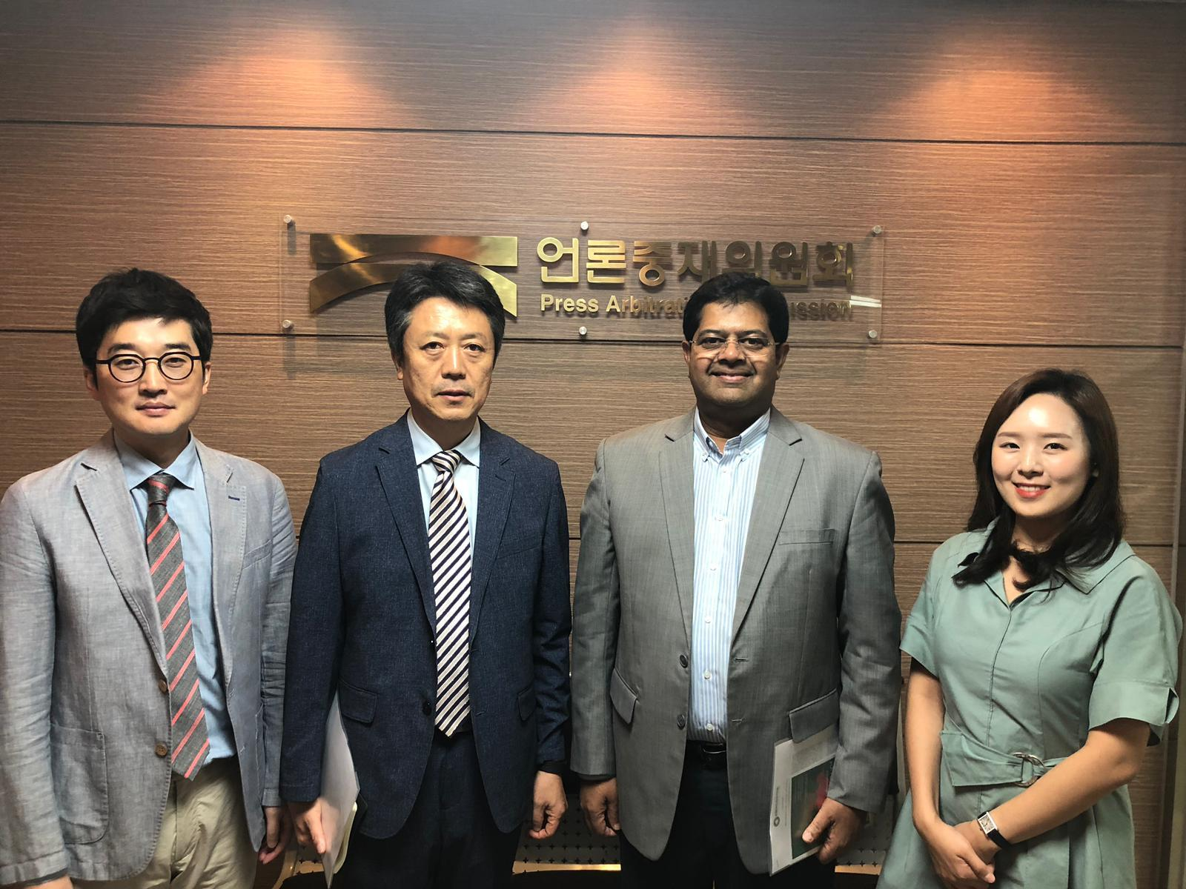
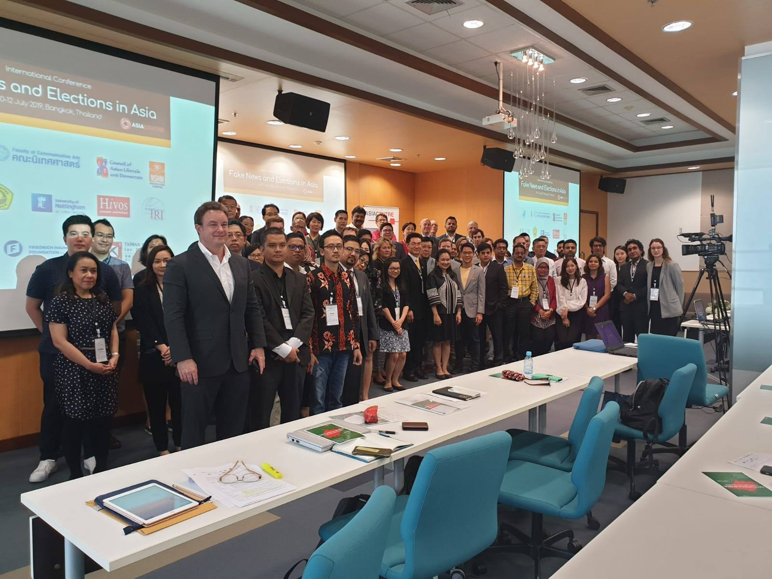
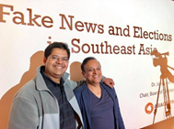
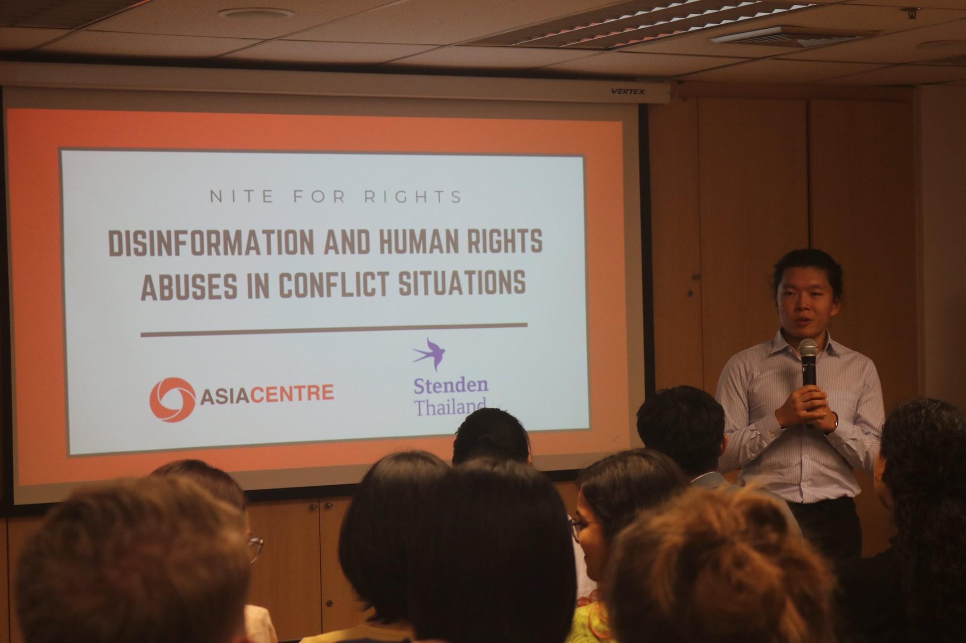
Asia Centre’s Ongoing Works on
Fake News and Freedom of Expression
Activities

Slide 27
Asia Centre’s Ongoing Works on
Fake News and Freedom of Expression
International Conference on Fake News and Elections in Asia (10-12 July, 2019)

Slide 28
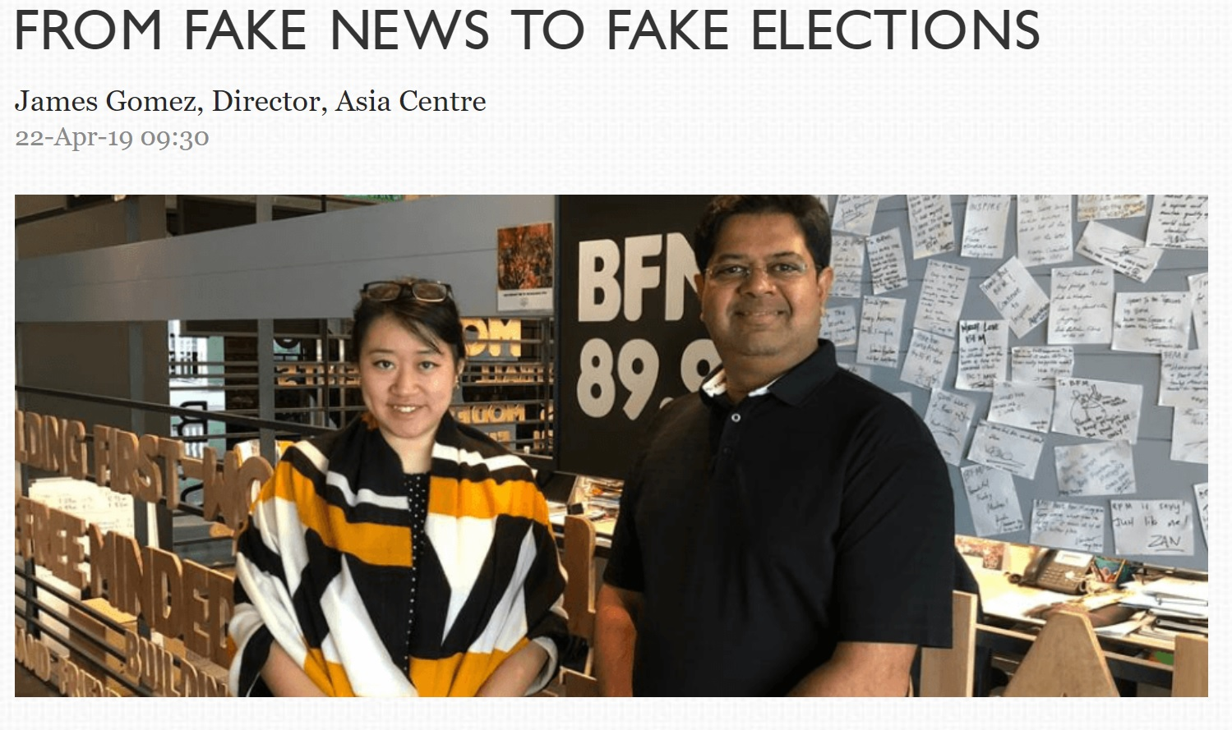
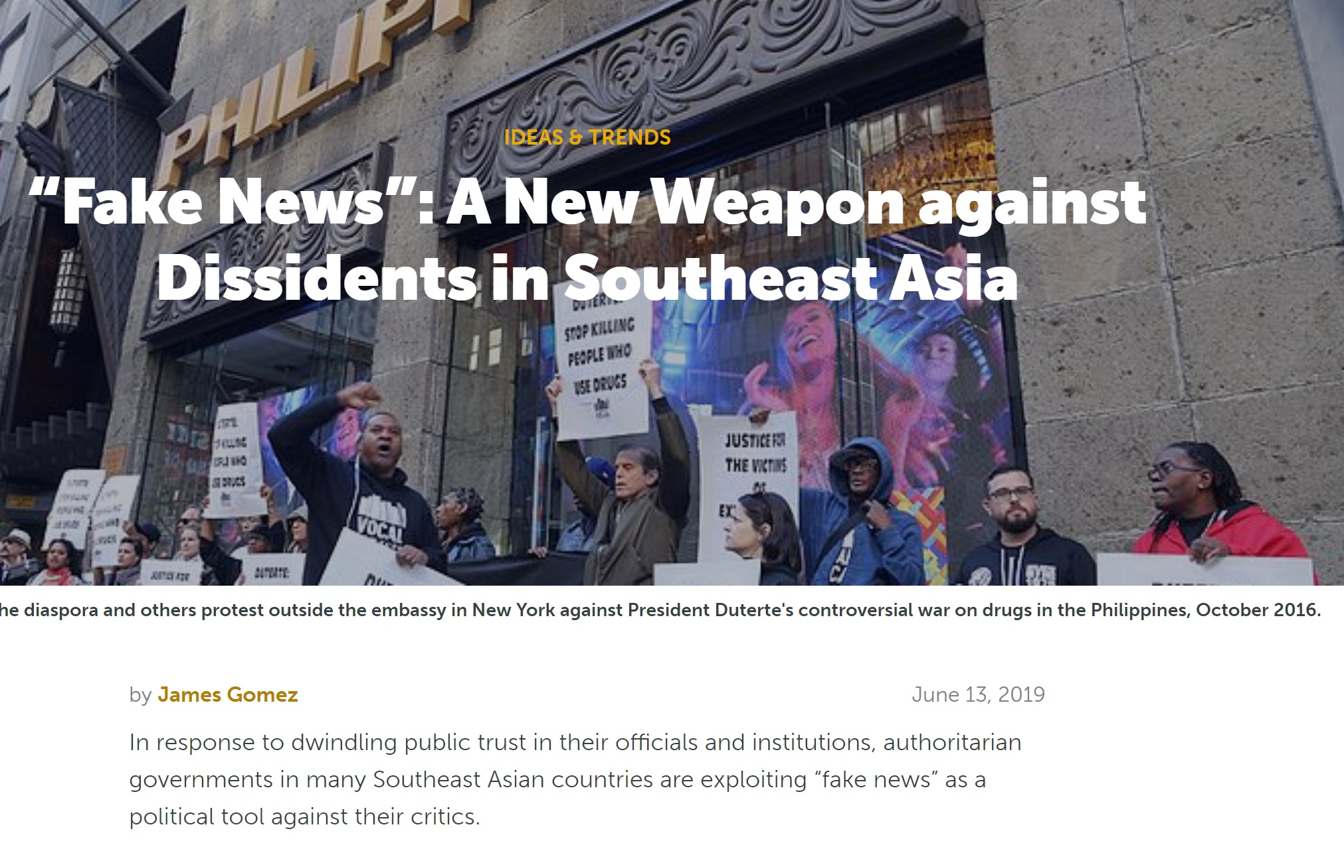
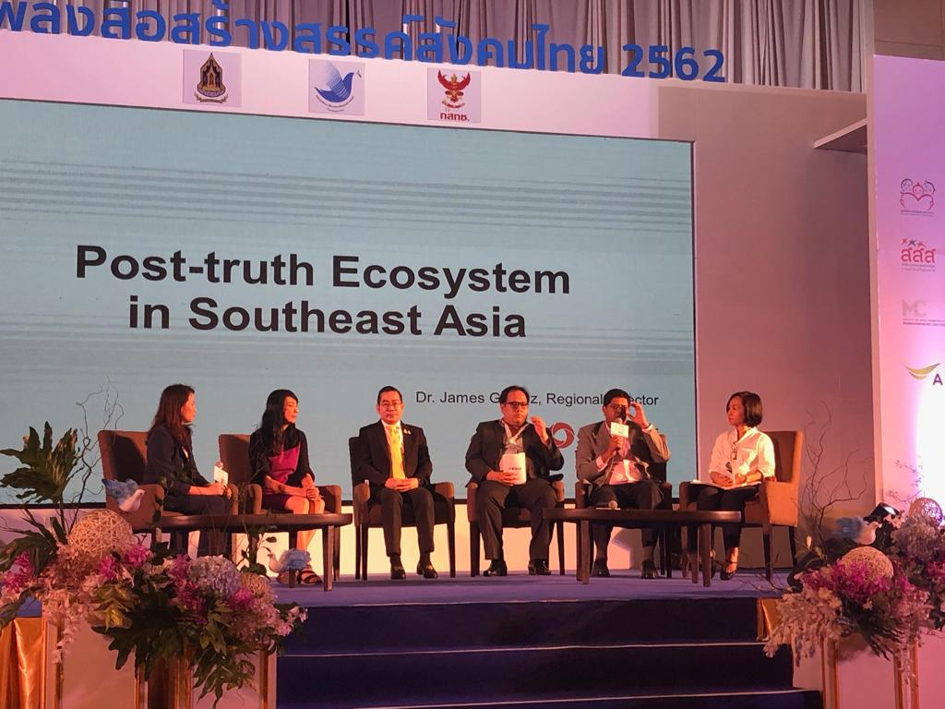
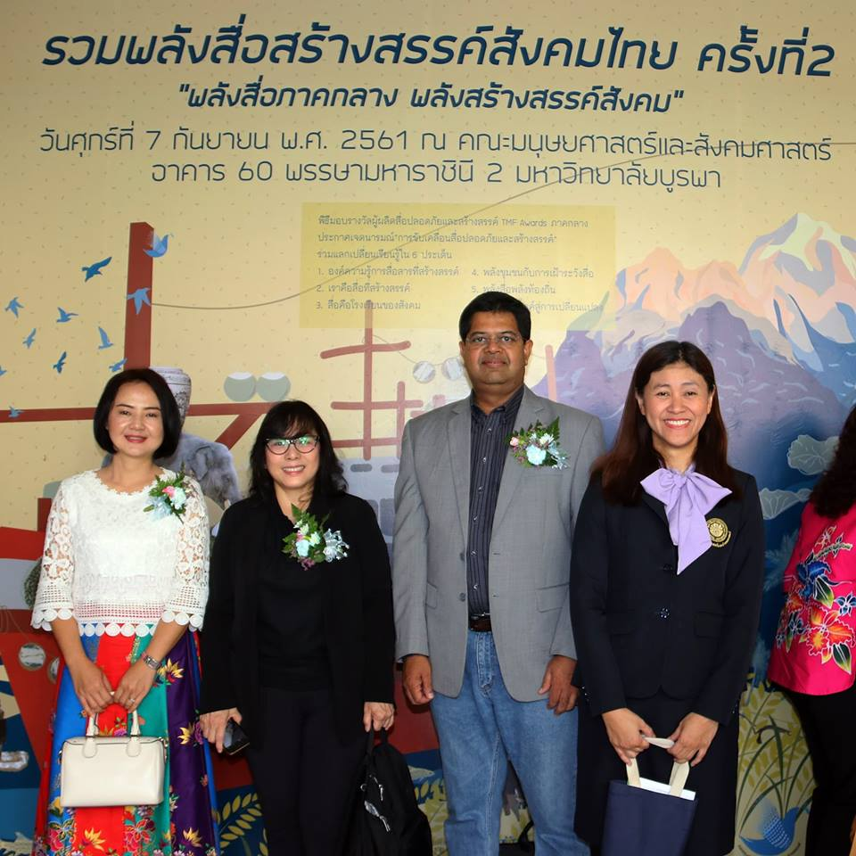
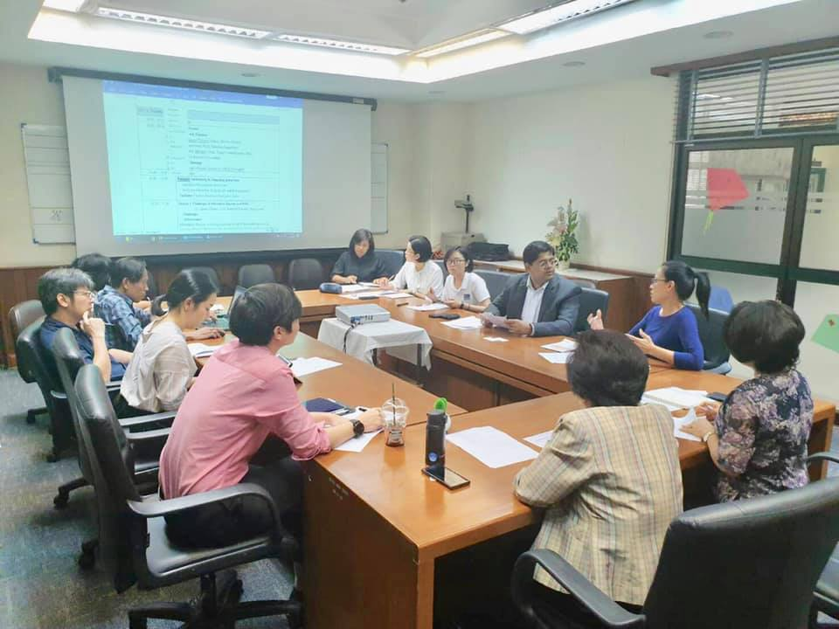
Asia Centre’s Ongoing Works on
Fake News and Freedom of Expression
Advocacy

Slide 29
Contact Details
For collaborations
Contact:
contact@asiacentre.org

