Slide 1
The Columbia Jurisprudence Conference
11 March 2015
Important developments in 2014:
FREEDOM OF EXPRESSION IN SOUTH AFRICA
DARIO MILO
Partner, Webber Wentzel, Johannesburg
Visiting associate professor, Wits University
Twitter: @dariomilo
Blog: dariomilo.com

Slide 2
PART 1: FREEDOM OF EXPRESSION IN SOUTH AFRICA in 2014
THE GOOD, THE BAD AND THE UGLY: see DARIOMILO.COM – "2014: A Bumper Year for Media Law"
KEY COURT DECISIONS IN 2014:
MORE ACCESS TO COURTS
Access to broadcast Oscar Pistorius' trial for murder
LESS ACCESS TO COURT DOCUMENTS
High Court's decision in SANRAL v City of Cape Town
MORE ACCESS TO INFORMATION
Access to the Khampepe-Moseneke report regarding Zimbabwe elections
National Key Points Act: Right2Know Campaign v Minister of Police
ArcelorMittal (access to information held by private bodies)
CRIMINAL DEFAMATION:
Alive and well in South Africa, but not in Zimbabwe

Slide 3
PART 2: WHAT TO WATCH OUT FOR IN 2015
CASES
Broadcasting Parliament case
Judgment in appeal of court documents case in Sanral v City of Cape Town
LEGISLATION
Protection of State Information Bill
Regulation of internet content

Slide 4
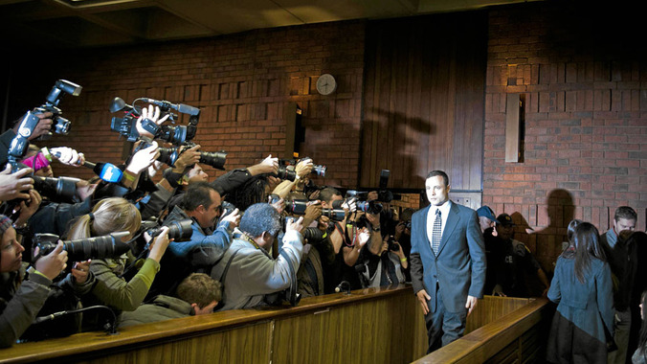
MORE ACCESS TO COURTS Broadcasting Oscar Pistorius' trial

Slide 5
broadcastIng oscar Pistorius' trial
First time criminal case broadcast in South Africa
Entire trial could be broadcast by live audio
The media could televise or livestream:
the opening and closing arguments
any interlocutory applications
the judgment
the evidence of the experts and police witnesses for the state
as well as any lay witness who consented to being televised
Judge accepted was necessary to balance open justice with fair trial
This gave public firsthand account of what had happened in trial
Court referred to the Thatcher case (SA case) which conducted a detailed comparative analysis of the legal landscape on broadcasting in the UK, USA, Canada, Australia, New Zealand, Germany, France, Italy

Slide 6
less ACCESS TO COURT DOCUMENTS: Western Cape High Court's decision in Sanral v City of Cape Town

Slide 7
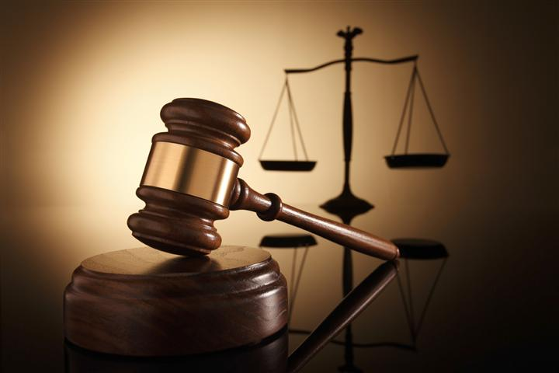
judge binns-ward's decision in sanral v city of cape town
Case concerns the City of Cape Town's judicial review of a decision in terms of legislation to declare part of two key national highways as toll roads.
In an interlocutory application the South African National Roads Agency Limited (SANRAL) argued that part of the City’s supplementary affidavit should not be made public, as it contained sensitive and confidential information provided to the City by SANRAL in the litigation.

Slide 8
judge binns-ward's decision in sanral v city of cape town
Court interpreted Rules as only permitting access by the High Court registrar to persons with a direct legal interest in the case – this would typically exclude the media.
Court held that a party to litigation who receives documentation from his opponent under compulsion in terms of the rules, cannot make that documentation public without the consent of his opponent – OR amounts to contempt of court.
Court stated that the media could bring a court application for access – an expensive and slow process.
Presently on appeal - March 2015 Supreme Court of Appeal hearing
Court referred extensively to cases in England as well as cases in Canada, USA and Australia

Slide 9
more ACCESS TO INFORMATION UNDER FOI LEGISLATION
3 KEY CASES IN 2014 –
International relations
national security
pollution by a corporation

Slide 10
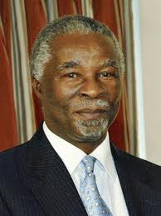
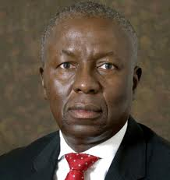
CASE 1: khampepe-moseneke report
In 2002 the former President, Thabo Mbeki, dispatched two sitting judges (Deputy Chief Justice Dikgang Moseneke and Justice Sisi Khampepe) to Zimbabwe to conduct an investigation on the elections.
Judges sent "to assess the constitutional and legal challenges that had emerged in Zimbabwe and to report on those matters to the President directly in confidence".

Slide 11
access to information: khampepe-moseneke report
The matter was heard by 22 judges over the course of 6 years
The case illustrates the length to which the state will sometimes litigate to prevent embarrassing information being made public
At one stage, report mysteriously disappeared from chambers of High Court judge who was deciding case
Justice Fritz Malan in the Supreme Court of Appeal referred to one of the presidency’s litigation tactics as “an abuse of process that cannot be tolerated”
Eventually judges took "judicial peek" at report and rejected Presidency's grounds of refusal based national security grounds (that report was commissioned to inform policy and that it contained confidential communications from Zimbabwe state officials)
Constitutional Court refused leave to appeal by presidency
Constitutional Court case (2011) referred to cases in USA, Canada and Australia

Slide 12
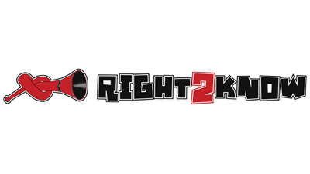
National key points act: right2know v minister of police
PAIA Request by the Right2Know campaign for a list of the structures deemed 'National Key Points' under the National Key Points Act.
Refusal by the State was justified on basis that key points were "pivotal" to the "security" and "stability" of the country and by disclosing the list would prejudice the security of the owners and the "defence and safety" of the country.

Slide 13
right2know v minister of police
Judge found that state had not put up enough evidence that justified the grounds for refusal-
no foundation for idea that individuals will or may be harmed; and
no evidence that disclosure of key points will threaten security of the Country.
The attempt to keep the list secret was undermined by the fact that ministers had furnished details of key points to Parliament “for the whole world to know, including, presumably, those dark forces that lurk in wait to disturb our tranquility”.

Slide 14
Arcelormittal and private bodies
Significant case concerning a private body
Vaal Environmental Justice Alliance was successful in PAIA application for information relating to ArcelorMittal's operational and strategic approach to the protection of the environment into the areas where it operates steel plants.
Usually a requester has to meet a strict threshold requirement that it requires the records sought for the exercise of protection of its rights.
The Supreme Court of Appeal held that as advocates for environmental justice, the requester was entitled to rely on various environmental law statutes in complying with the threshold requirement. The statutes emphasised the importance of consultation and interaction with the public.

Slide 15
criminal defamation
Alive and well in South Africa, but not in Zimbabwe

Slide 16
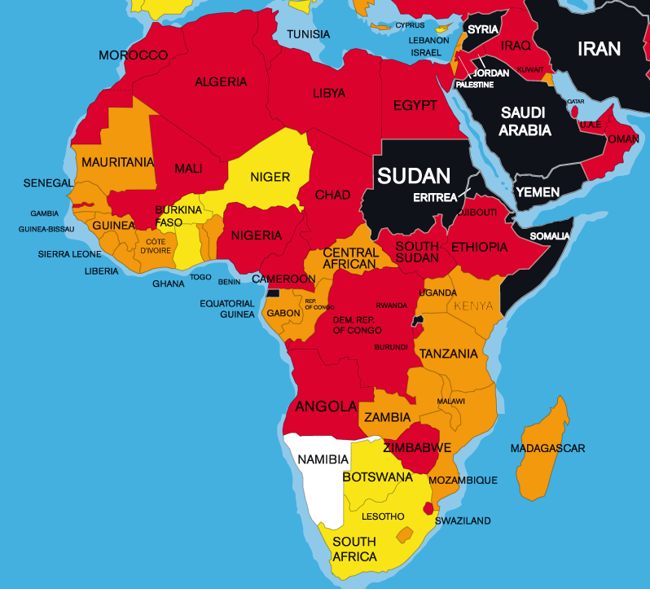
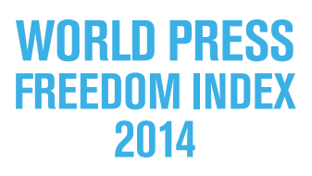
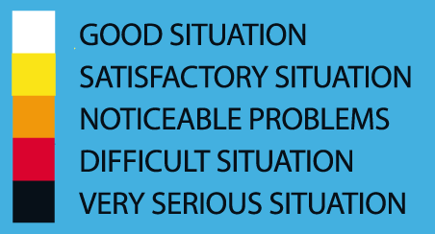
Zimbabwe: criminal defamation

Slide 17
Zimbabwe: CRIMINAL DEFAMATION
June 2014: In Madanhire v A-G Court delivers impressive, unanimous judgment per Patel JA
What is distinctive about criminal defamation is the stifling or chilling effect of its very existence on the right to speak and the right to know
Moreover, there is an appropriate and satisfactory alternative civil remedy that is available to combat the mischief of defamation
It is a disproportionate instrument for achieving the intended objective of protecting the reputations, rights and freedoms of other persons
It is not reasonably justifiable in a democratic society
Referred to learning from international and regional bodies:
United Nations Commission on Human Rights and Human Rights Committee, African Commission on Human and Peoples’ Rights
Referred to South Africa article by Ben Winks and Vinayak Bhardwaj

Slide 18
Zimbabwe: CONTINENTAL SHIFT?
African Court of Human and Peoples' Rights, Konate v Burkina Faso (also 5 December 2014)
Majority of 6: Criminal defamation is not, as such, incompatible with the African Charter, but it should never be punished by imprisonment
Minority of 4: There is no justification for any criminal sanction for defamation, custodial or not, as the civil law should be sufficient
Court referred to cases and learning from the UN Human Rights Committee, the ECHR, and the Inter-American Court

Slide 19
Criminal Defamation
But in South Africa –the crime of defamation upheld
High Court of South Africa, Motsepe v The State (also 5 December 2014)
Mag Court imposed R10 000 fine or 10 months' imprisonment (suspended for 5 years on condition that the appellant not convicted of criminal defamation during the period)
Freedom of expression is not unlimited
Though criminal defamation undoubtedly limits freedom of expression, this is reasonable and justified in an open and democratic society
On the facts: found that journalist didn't have intention to defame, so not guilty
Court referred to learning from African Commission on Human and Peoples Rights, the ECHR, the United Nations, the Organisation of American States and the Organisation for Security and Cooperation in Europe and a decision by the Privy Council

Slide 20
PARt 2: What to Watch out for in 2015

Slide 21
PART 2: WHAT TO WATCH OUT FOR IN 2015
Judgment in the 'Broadcasting Parliament' case
Media freedom in Parliament
Recent urgent application for an interim interdict to prevent Parliament from jamming communications and from failing to broadcast disturbances during the South African 2015 State of the Nation Address
Matter being argued in April 2015

Slide 22
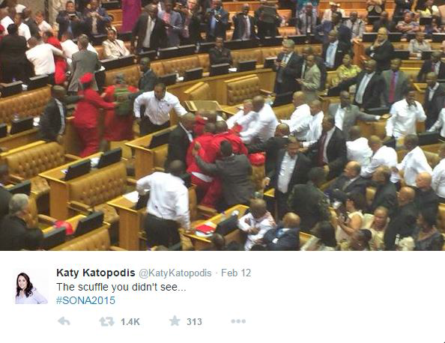
media freedom in parliament

Slide 23
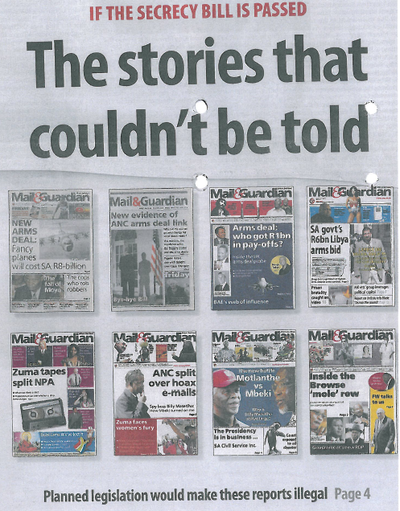
NATIONAL SECURITY: The Protection of State Information (Secrecy) Bill
On 12 November 2013, the South African National Assembly adopted a revised version of the Secrecy Bill, with 225 members of Parliament voting in favour and 88 voting against.
The Secrecy Bill was sent to President Jacob Zuma for assent in December 2013.
Still awaits his signature
Creates offences of possession and disclosure of classified information with limited defences
Following Al Jazeera's and The Guardian's release of "Spy Cables" involving SA's National Intelligence Agency, likely that Bill will be signed into law soon

Slide 24
THE FILMS AND PUBLICATIONS BOARD – proposed regulation of internet content
Crux of the Policy: provides for a system of co-regulation of online content whereby a distributor of online content could either submit publications to the Board for classification or could conclude an online distribution agreement in terms of which the distributor may become accredited to classify its online content prior to distribution.
Purports to apply to films, games and "certain publications"
Crucially - draft policy provides that it's impermissible to distribute digital content in the Republic of South Africa unless such content is first classified and the classification is displayed
Also purports to empower FPB to demand take-down of user-generated content where the content has not been classified

Slide 25
CONCLUSION
2014 was a significant year for media law in South Africa
Cutting-edge cases (eg broadcasting the Pistorius trial)
The courts generally responded well (as have in the past)
But very disappointing judgments upholding criminal defamation and restricting access to court records
Much to celebrate but go into 2015 knowing many legislative and executive threats to media freedom await us

